Slide 1
History of DevOps

Slide 2
History of DevOps
Agile Conference 2008
Patrick Debois and Andrew Shafer discuss “Agile Infrastructure”
October 2009
Patrick Debois starts “DevOpsDays” in Ghent, Belgium
Velocity 2009
John Allspaw and Paul Hammond present “10 Deploys per Day: Dev and Ops Cooperation at Flickr”
2010-
DevOpsDays spread globally
OSS Tools like Chef, Puppet, Vagrant, LogStash, Jenkins etc. gain popularity
March 2011
Cameron Haight of Gartner predicts explosion of DevOps in Global 2000 companies

Slide 3
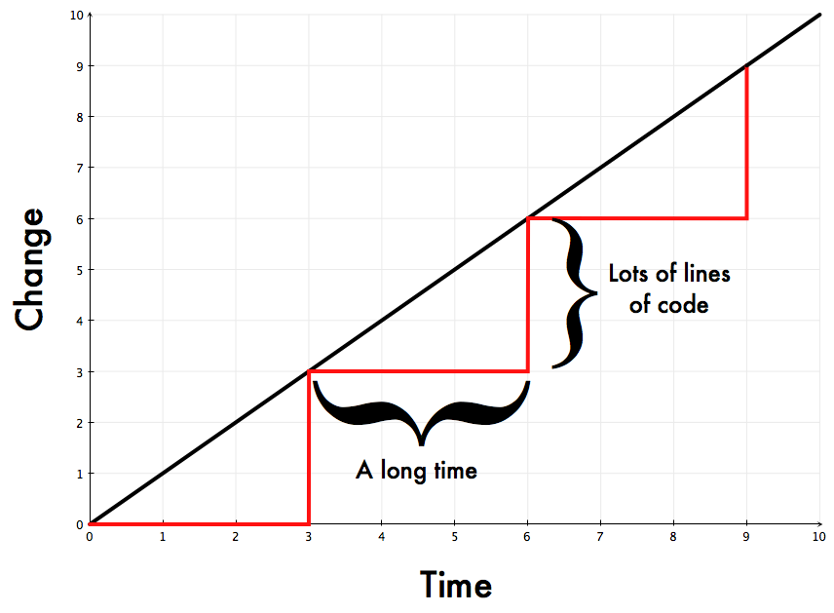

John Allspaw’s visual – Slow delivery cycles

Slide 4
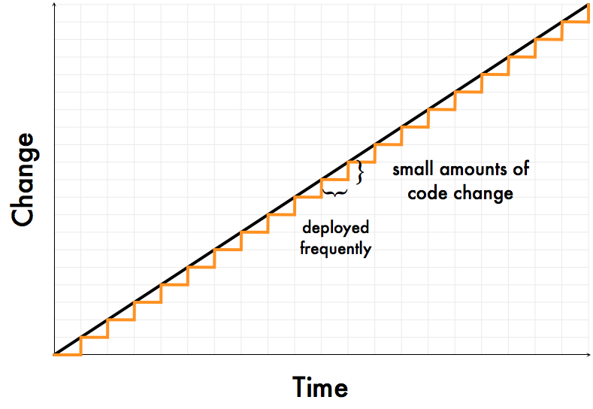

John Allspaw’s visual – Fast delivery cycles

